Slide 1
Computational Thinking, Problem Solving, and Programming
TOPIC 4.0 – Computational thinking
TOPIC 4
4.3.10 – 4.3.13: The Return of the Collection and Procedures

Slide 2
TOPIC 4.3.10 – COLLECTIONS
COLLECTION RECOLLECTION
A collection is similar to an array, but it can have a variable length
A collection can contain any number of data types
Collection uses methods to access data
COLLECTION.addItem(“Joe”)
output COLLECTION.getNext()
COLLECTION.hasNext()
COLLECTION.resetNext()

Slide 3
TOPIC 4.3.10 – COLLECTIONS
COLLECTION RECOLLECTION
Collections are ordered, so each item has a specific place in the collection
Collections are not a construct that exist in most programming languages
Most languages have other abstract data types to store info

Slide 4
TOPIC 4.3.10 – COLLECTIONS
COLLECTION ALTERNATIVES
Arrays
Simplest alternative
Has a fixed size
Can only store one type of data
Lists
Most common alternative
Has variable size
Can store multiple types of data (usually doesn’t though)

Slide 5
TOPIC 4.3.10 – COLLECTIONS
LIST OPERATIONS
Lists are the most common type of collection in Python
listName = [“item”, 23, 45.2, True]
To add item:
listName.append(<item>)
To remove item:
listName.remove(<item>)
listName.pop(<index>)
To get item:
listName[<index>]

Slide 6
TOPIC 4.3.10 – COLLECTIONS
LIST OPERATIONS
listName = [“Joe”, 23, 54.3, “Mama”]
print(listName[0]) #prints Joe
listName.pop(0)
print(listName[0]) #prints 23
listName.append(“Joe Again”)
print(listName[3]) #prints Joe Again

Slide 7
TOPIC 4.3.10 – COLLECTIONS
LIST OPERATIONS
#loop through a list to print all elements in it
for i in range(len(listName)):
print(listName[i])
#loop through a list to double every element in it
for i in range (len(listName)):
listName[i] *= 2

Slide 8
TOPIC 4.3.10 – COLLECTIONS
LISTS OF LISTS
listName = [
[“Joe”, “James”, “Jerry”],
[“Gerald”, “George”, “Gimp”],
[“Alex”, “Abby”, “Audrey”]]
print(listName[1][2]) #Gimp

Slide 9
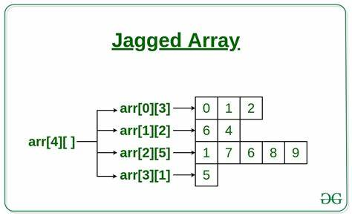
TOPIC 4.3.10 – COLLECTIONS
LISTS OF LISTS
Lists of lists (also called 2D lists) can be used to represent grids or subgroupings
Lists can also become 3D, 4D, etc.
These can get very difficult to understand
Each sub-list can be of a different length
This is what we call a ‘jagged array’

Slide 10
TOPIC 4.3.10 – COLLECTIONS
LISTS OF LISTS
Print out a list of lists
for i in range(len(listName)):
for j in range(len(listName[i])):
print(listName[i][j])
This nested for loop will print out every element in a 2D list

Slide 11
TOPIC 4.3.11 – COLLECTIONS
LISTS USES
Find number of times “Bob” is in a list of lists
numBob = 0
for i in range(len(listName)):
for j in range(len(listName[i])):
if listName[i][j] == “Bob”:
numBob += 1
print(“Number of Bobs is: ”, numBob)

Slide 12
TOPIC 4.3.12 – COLLECTIONS
WHY COLLECTIONS/LISTS?
Why do we use collections/lists?
Helps us save space, don’t need a variable for each value in collection
Can have a variable number of things
Useful if user can input any number of things
Easy logical grouping for us to understand
Very easy to loop on compared to individual variables
Predefined procedures (.add, .remove, .pop) allow us to easily modify what’s in the collection

Slide 13
TOPIC 4.3.12 – PROCEDURES
WHY PROCEDURES?
We can pass lists or collections to procedures as well
This allows us to create our own modular operations
Printing out entire list
Count number of element in list
Remove duplicates from list

Slide 14
TOPIC 4.3.12 – PROCEDURES
REMOVE DUPLICATES
def removeDuplicates(list):
newList= []
for i in range(len(list)):
if list[i] not in newList:
newList.append(list[i])
return newList

Slide 15
TOPIC 4.3.13 – PROCEDURES
PROCEDURES IN CONTEXT
Now that our procedures are defined, we can use them as parts of our algorithm
Goal: Find the name of each student who showed up this week
monday = [“Jimbob”, “Yosh”]
tuesday = [“George W. Bush”]
wednesday = [“Jimbob”, “Billiam”]
thursday = []
friday = [“Yosh”, “Billiam”]
attendance = monday + tuesday + wednesday + thursday + friday
attendance = removeDuplicates(attendance)

Slide 16
TOPIC 4.3.12 – PROCEDURES
PROCEDURES REVIEW
Recall our discussions of procedures (sub-procedures)
They allow us to reuse portions of our algorithm separate from the main code
Also known as
Procedures
Sub-procedures
Function (you might hear me use this one sometimes)
Routine
Method (you will DEFINITELY hear me use this sometimes)
Subroutine
Modul

Slide 17
TOPIC 4.3.13 – PROCEDURES
PROCEDURES REVIEW
Procedures usually have one goal and one task only
Determine if a string is a palindrome
def palindrome(word):
for i in range(len(word)):
if word[i] != word[len(word) – 1 – i]:
return False
return True

Slide 18
TOPIC 4.3.13 – PROCEDURES
TUPLES
Tuples are similar to lists, but once created the data cannot be changed
newTuple = (“data”, “moreData”, 32)
print(newTuple[1]) #moreData

Slide 19
TOPIC 4.3.13 – PROCEDURES
COMBINATIONS
You can even do lists of tuples!
newList = [(“Joe”, “Mama”), (“Test”, “Data”)]

Slide 20
TOPIC 4.3.13 – PROCEDURES
FINAL CHALLENGE
Write a program that averages the BMI of a list of people who are represented by a tuple that contains their (<height>, and <weight>)
This should be written in a procedure
You don’t have to get user input for the height and weight but you can if you’d like

Slide 21
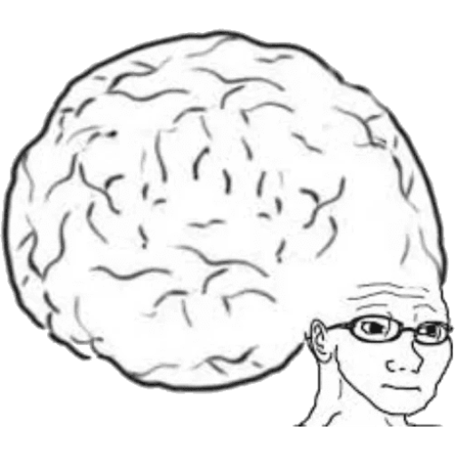
TOPIC 4.3.13 – THINKING Logically
Vocab to remember
List
Tuple
Collection
Procedure
2D List

